Slide 1
Retail Sales Dashboard
Interactive Analysis for Business Decision-Making

Slide 2
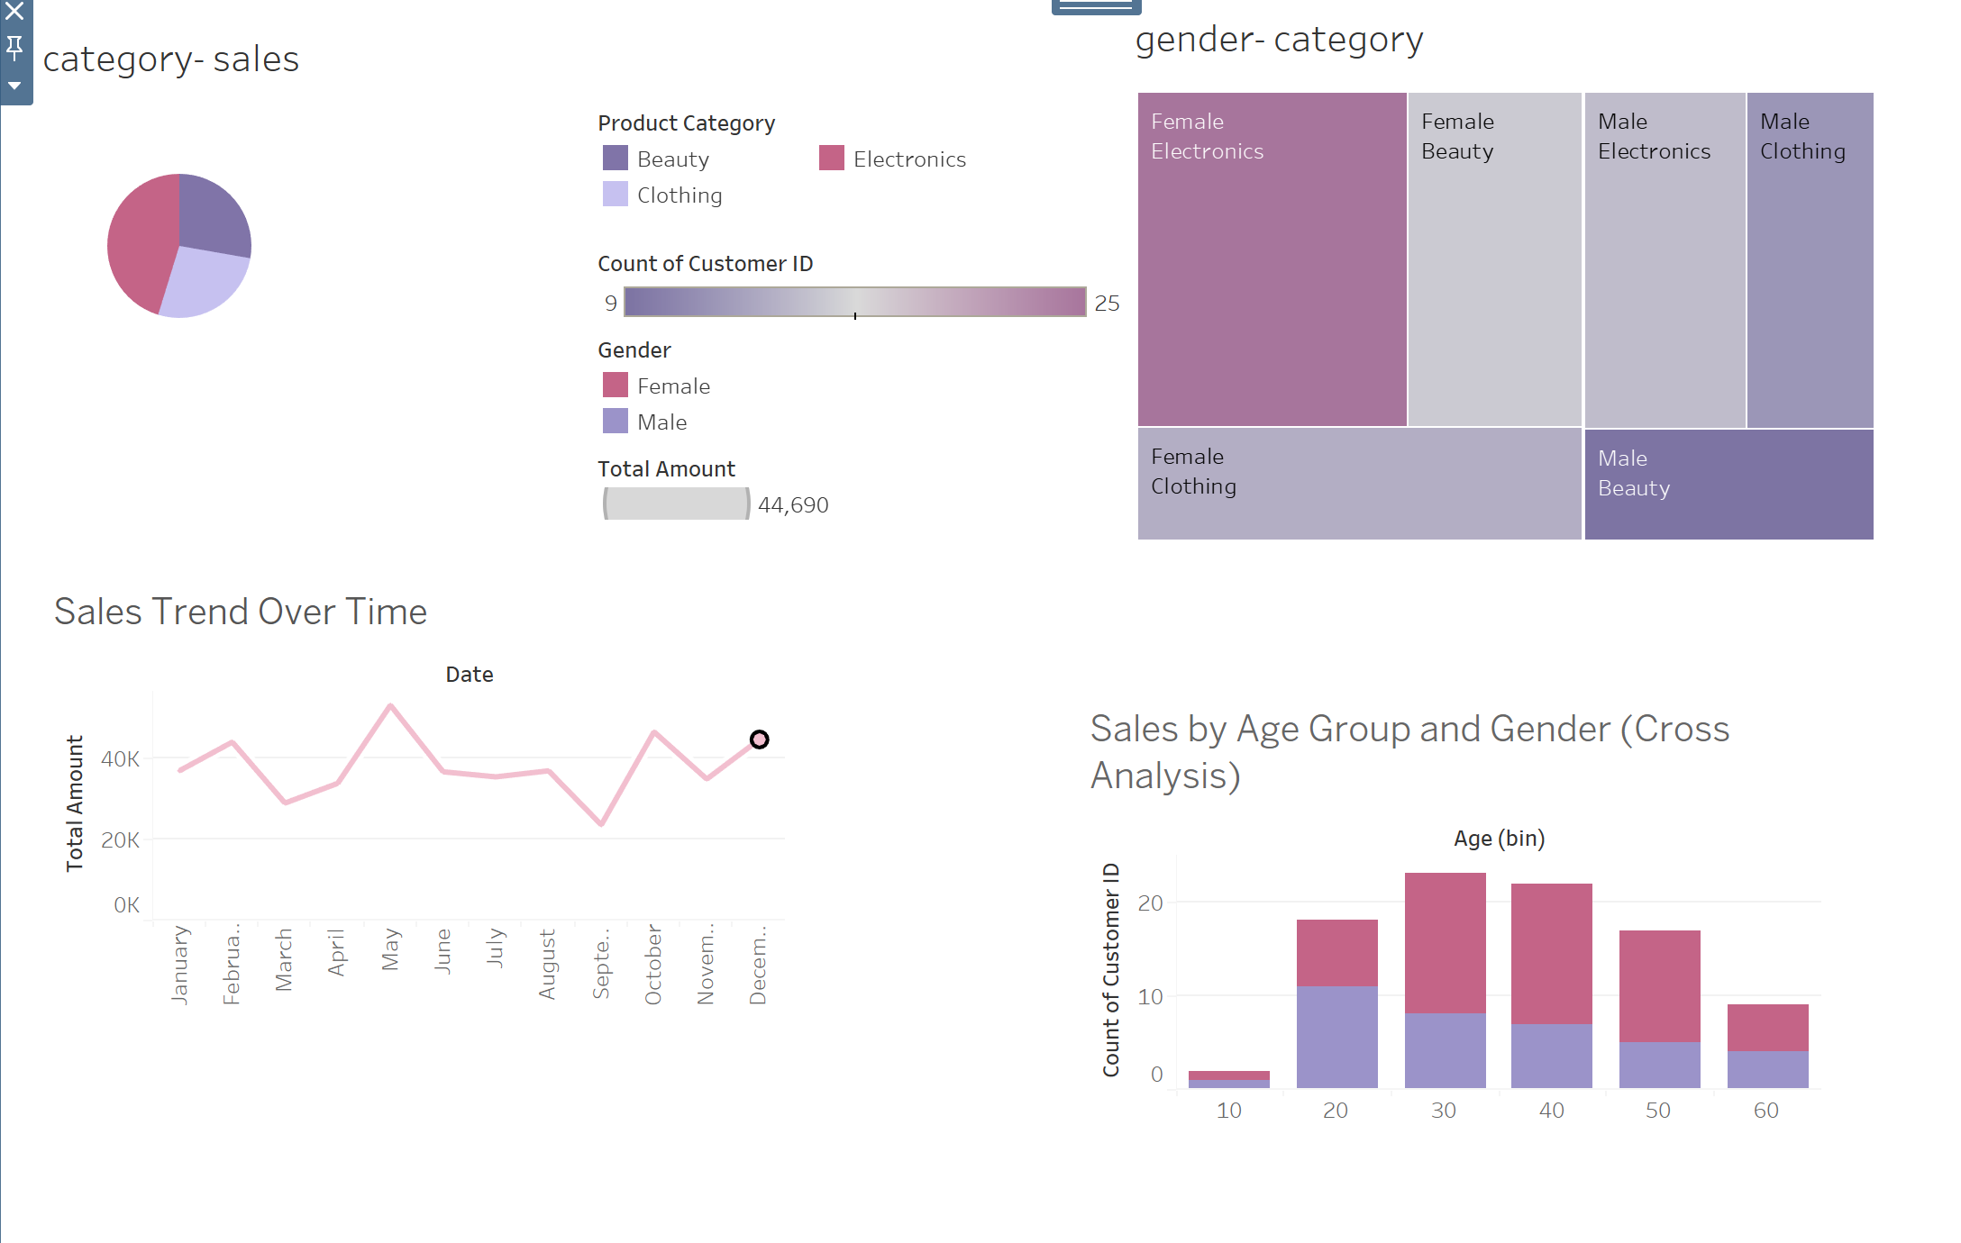
Introduction
To provide a comprehensive analysis of retail sales across various customer demographics and product categories using interactive Tableau dashboards.
Scope:
Sales distribution by category
Gender-based purchase behavior
Monthly sales trends
Age-wise customer segmentation

Slide 3
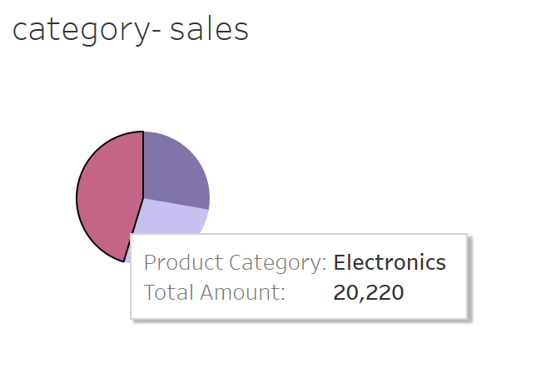
Category-wise Sales Distribution
Insight:
Electronics leads in sales with a total amount of 20,220, showing strong customer interest and revenue potential.
Beauty and Clothing follow, with Clothing contributing the least.

Slide 4
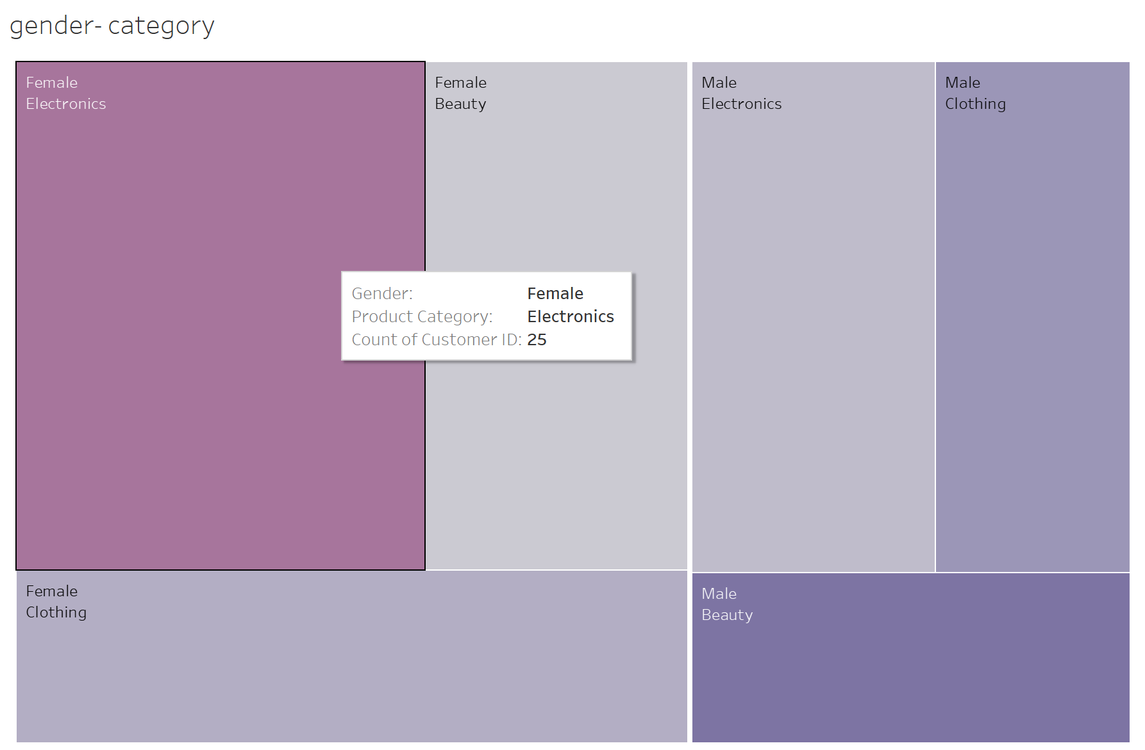
Gender-Category Cross Analysis
Insight:
Female customers drive Electronics and Beauty sales more significantly.
Male customers are more inclined towards Clothing and also participate in Electronics and Beauty segments.

Slide 5
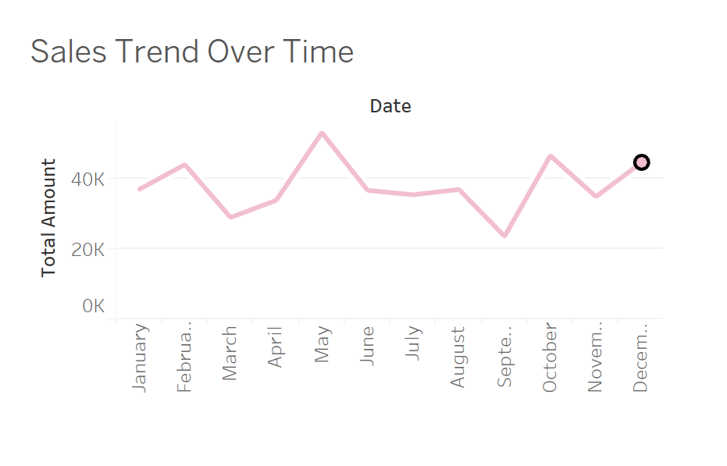
Monthly Sales Trends
Insight:
Sales remain relatively steady, with spikes observed in May and October–December, possibly due to seasonal events or promotions.

Slide 6
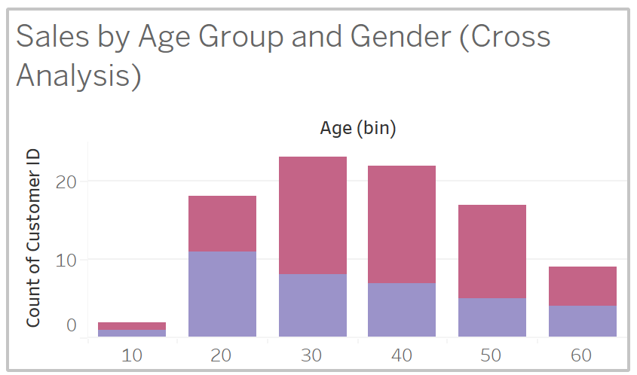
Age Group and Gender Insights
Insight:
The 30–40 age group is the most active in purchasing, followed by the 20–30 group.
Across all age groups, female customers show higher engagement than males.

Slide 7
Conclusion & Recommendations
Summary:
Beauty and Electronics are leading categories.
Female customers dominate in most segments.
Sales peaks in specific months offer planning opportunities.
Age-focused strategies can optimize engagement.
Next Steps:
Launch seasonal promotions aligned with trends
Gender-personalized product bundling
Consider loyalty programs for 20–40 age group customers

